Slide 1
X-section G-H
See Cross section locations.kmz & Cross section labels.kmz for location in Google Earth
First interpretation of the Knysna Basin as a flooded valley

Slide 2
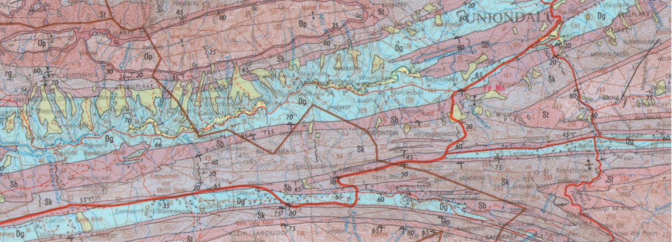
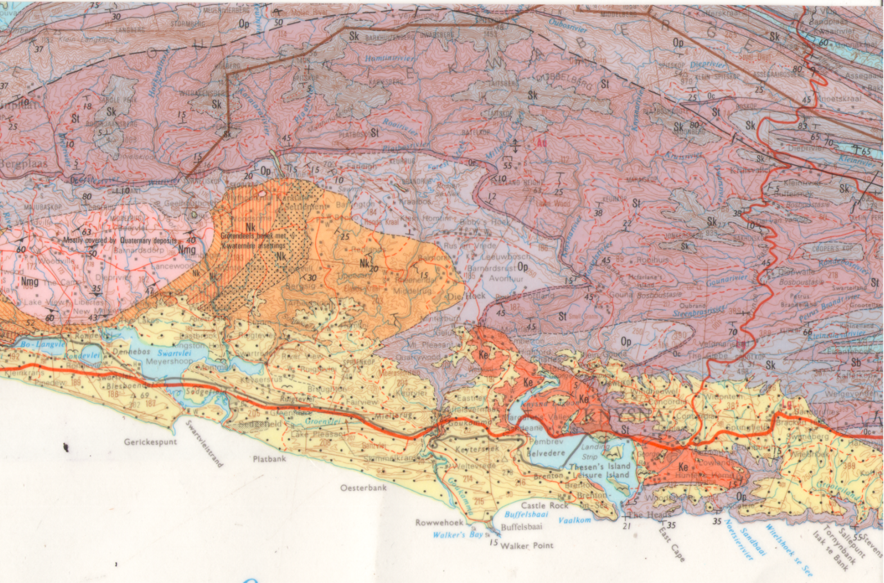
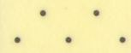
-1 Km
0
1 Km
0
G
Ng, Nm
Op
f
Dg
Sb
Gert Sass se Berg
5
f
St
Sk
Oc
f
Op
f
G
N9
Ngw, Nu, Nv, Ng
10
St
Sk
Taitsberg
Op
Bendigo Adit
Nmg
Oc
Two Other Mines
Generalised N-S Stratigraphic Geological Cross Section along Longitude 23° East
Location of Section Line N-S on Geology Map
Jubilee Creek
Bendigo GM
Shale Stops
20
Portland 187
Krisjan-se-Nek
Goudveld Boom
Op
St
N
N2
Ngw, Nu, Nv, Ng
Ke
30
Belvidere
0
5
10 Km
Sea
H
Km
Op
H
3322 OUDTSHOORN 1:250 000

Slide 3
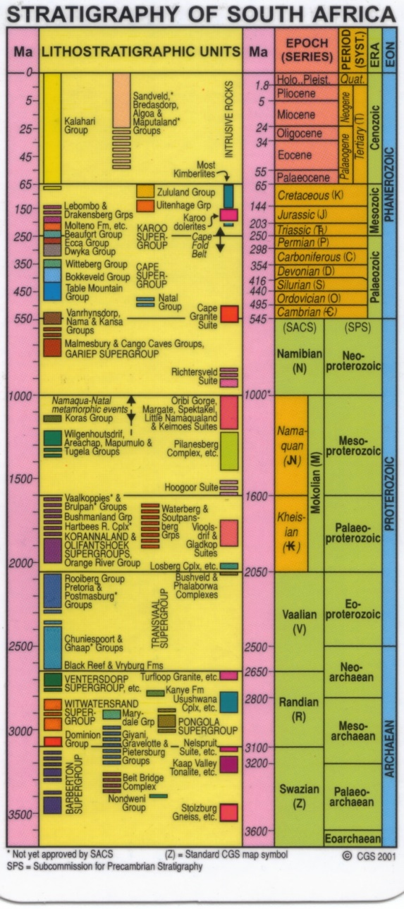

0
G
Ng, Nm
Op
f
Dg
Sb
Gert Sass se Berg
5
f
St
Sk
Oc
f
Op
f
Ngw, Nu, Nv, Ng
10
St
Sk
Taitsberg
Op
Bendigo Adit
Nmg
Oc
Generalised N-S Stratigraphic Geological Cross Section along Longitude 23° East
20
Portland 187
Op
St
Ngw, Nu, Nv, Ng
Ke
30
Belvidere
Sea
H
Km
Op

Slide 4
Second interpretation of the Knysna Basin as a graben

Slide 5
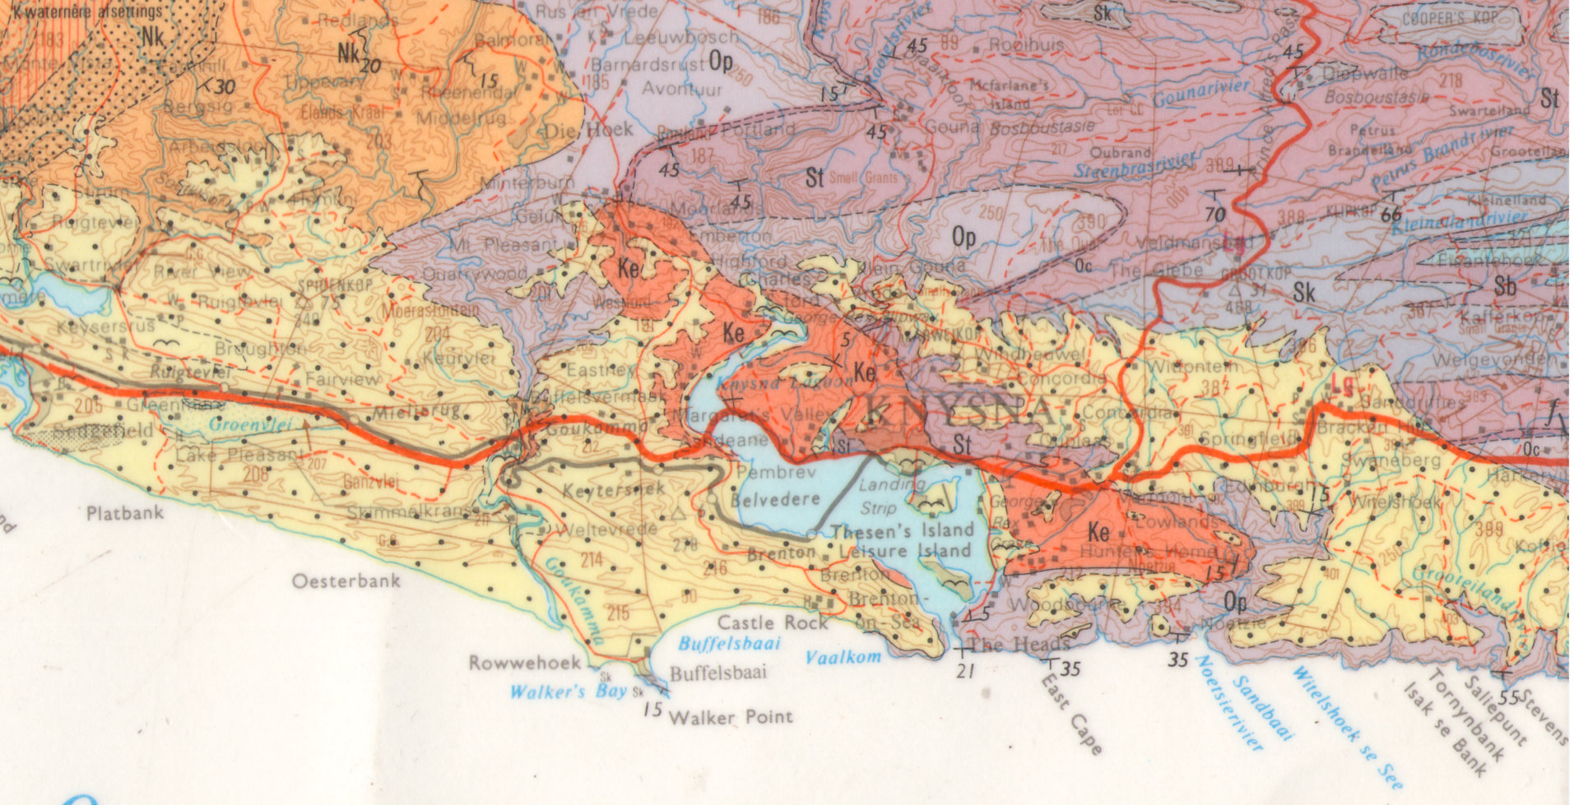
D
D
D
D
LEGEND
D
D
D
Inferred graben boundary fault with downthrown side indicated
Op: Peninsula Formation quartzite
Ke: Enon Formation conglomerate

Slide 6
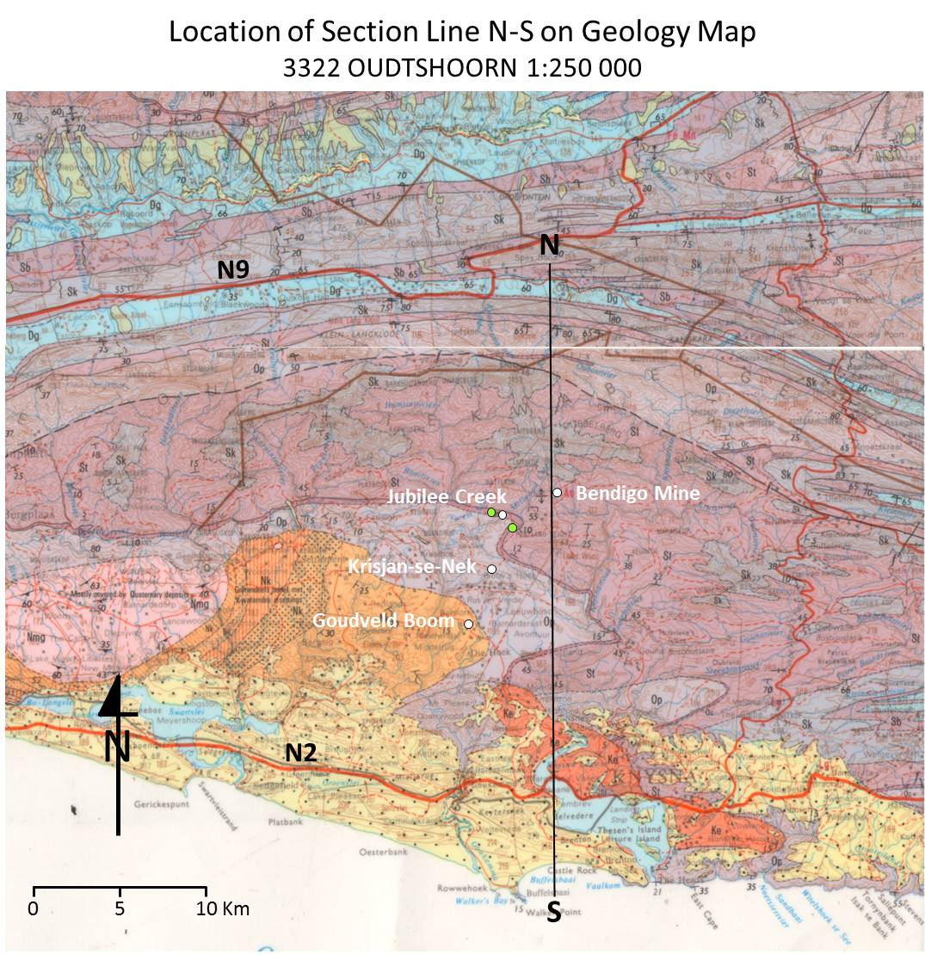
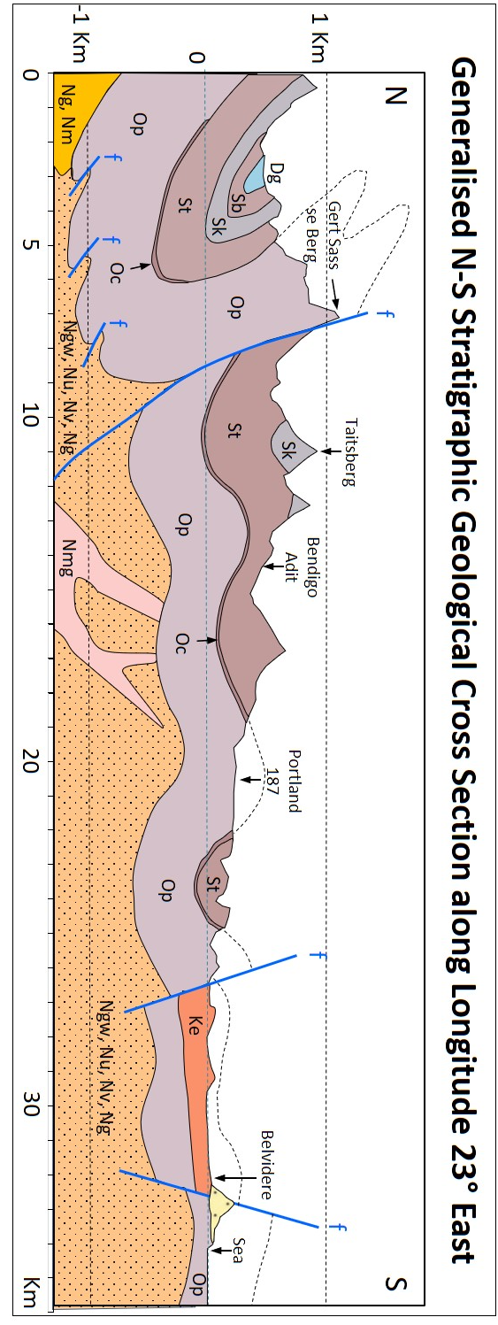
G
H
Figure 4

Slide 7
Third interpretation of the Knysna Basin as a half graben structure

Slide 8
D
D
LEGEND
D
D
D
D
Inferred half-graben boundary faults with downthrown side indicated
Op: Peninsula Formation quartzite
Ke: Enon Formation conglomerate

Slide 9
Generalised N-S Stratigraphic Geological Cross Section along Longitude 23° East
G
f
H
Gert Sass se Berg
Taitsberg
1 Km
Bendigo Mine
f
Dg
Sk
Portland
Knysna half-graben
Sb
Op
St
Ke
Belvidere
Sea
0
Sk
St
Op
St
Op
Oc
Op
Op
f
f
f
Oc
Ngw, Nu, Nv, Ng
-1 Km
Ng, Nm
Ngw, Nu, Nv, Ng
Nmg
0
5
10
20
30
Km

Slide 10
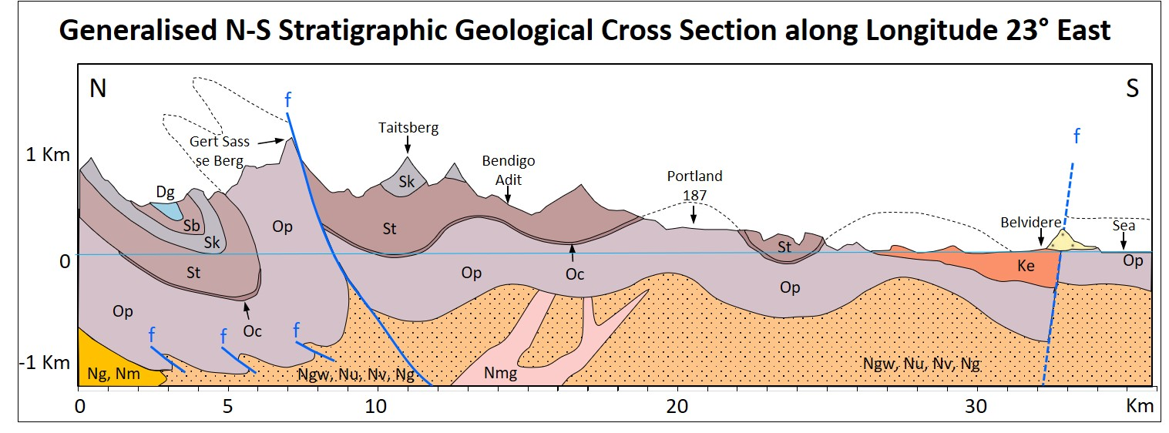
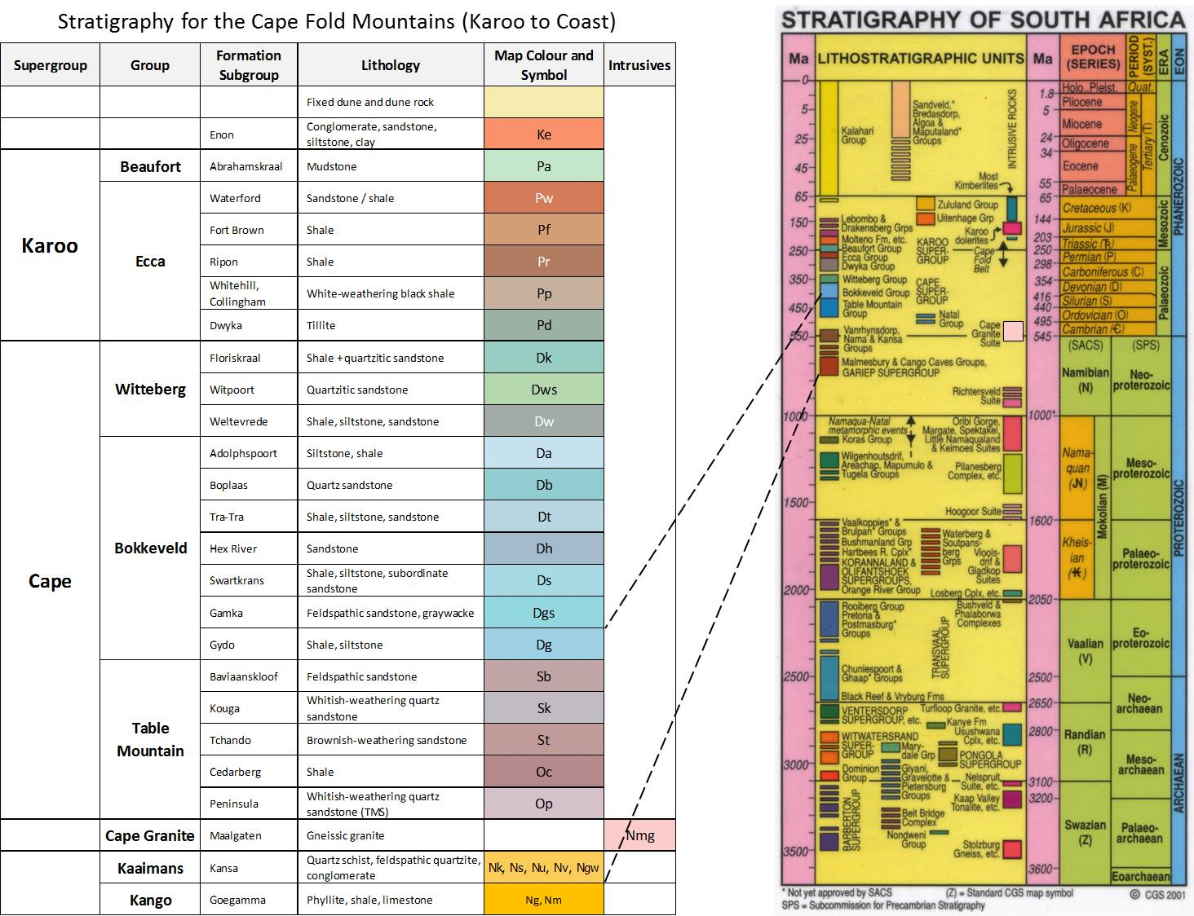
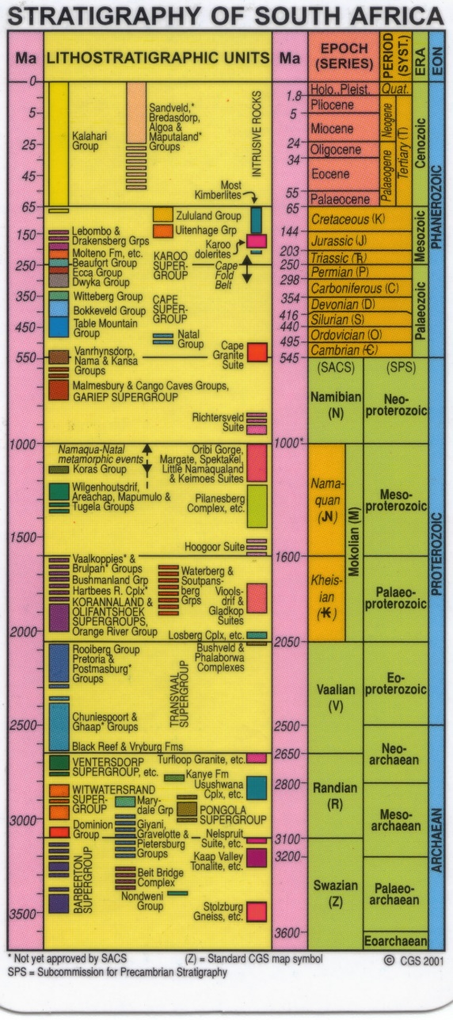
Cape Folding Event
Figure 5

